Slide 1
Class 3.2: Virtual bidding in wholesale electricity markets
S. Bose
Electrical and Computer Engineering
University of Illinois at Urbana Champaign
ECE 398 BD: Making sense of big data.
Fall 2018.

Slide 2
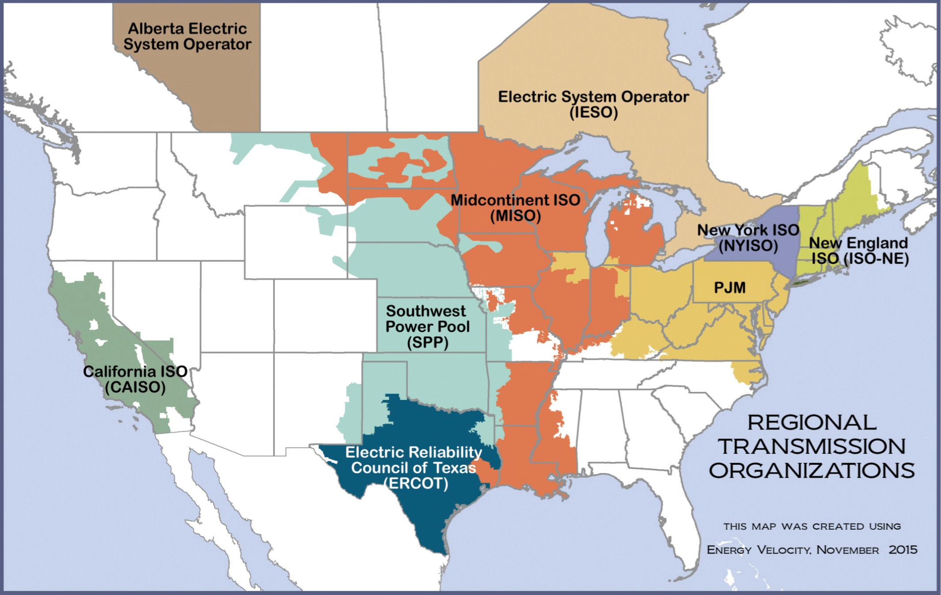
Energy deregulation led to the creation of power markets in the US in the 90’s.
Public Utilities Regulatory Policies Act (PURPA) in 1978
Energy Policy Act of 1992 (EPAct92)
FERC Order No. 888 in 1996.
Each Independent System Operator oversees the balance of demand and supply of power within its footprint.

Slide 3
Basics of market operations: supply offers and demand bids
Stack of supply offers
$/MW
Stack of demand bids
Market price
Cleared demand and supply
MW
7

Slide 4
Day-ahead and real-time markets
$/MW
Over each hour of a day, there are two markets held:
Day-ahead market that defines operations for each hour of the next day.
Real-time market that defines operations every 5 or 15 minutes on the operating day.
MW
$/MW
MW

Slide 5
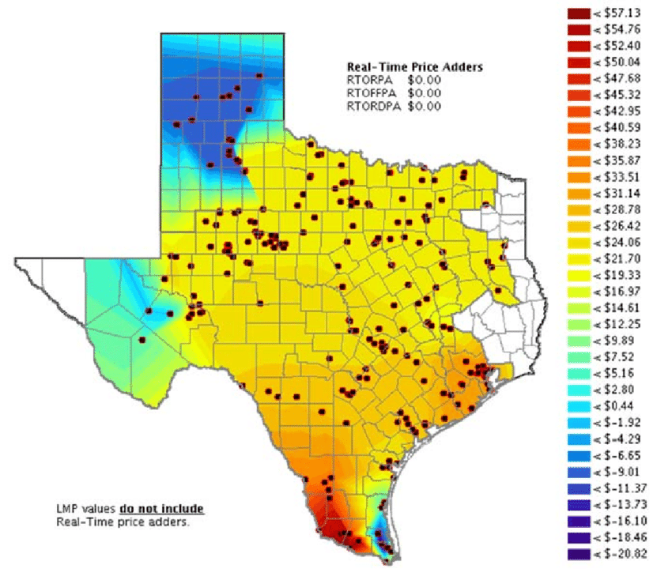
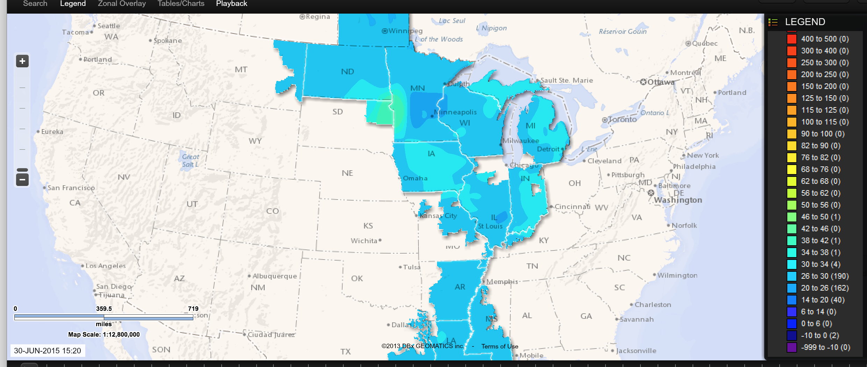
Electricity prices are locational in nature: locational marginal prices
Fact. Locational prices can even be negative!
Q. How?

Slide 6
Why is location important in electricity markets?
Generation capacity
Demand
Generation capacity

Slide 7
Why is location important in electricity markets?
3
2
1

Slide 8
Why is location important in electricity markets?
Line capacity = 1

Slide 9
Why is location important in electricity markets?
3
2
1
Line capacity = 1
1
3
2

Slide 10
Why is location important in electricity markets?
3
2
Line capacity = 1
1
Generator is not operational
or withholds generation

Slide 11
Locational marginal pricing
Cleared by the Independent System Operator in a way that the demand and supply of power at the buses induce feasible power flows through the network.
Price at a location reflects the locational need for power at that location.
Line capacity = 1
Think about how pricing works:

Slide 12
Zonal electricity prices in NYISO’s footprint
Time averaged over real-time prices for each hour
Price spread between day-ahead and real-time markets.
Q. One often uses the following thumb rule: lesser the price spread, higher the market efficiency. Why?

Slide 13
Virtual demand bids
Virtual bidders do not possess any physical generation or consumption asset. They bid or offer to arbitrage between day-ahead and real-time prices at various locations.
Virtual demand bid: Bid to buy power at day-ahead price at a particular zone and sell the same amount of power at the real-time price at the same zone.

Slide 14
Lab 3: Given historical price spreads, design an algorithm to bid into NYISO’s virtual bidding market.
Which (zone, hour) combination should we bid on? How much?

